Slide 2








INFANT IMMUNIZATION REMINDER
ANJUM AFROOZ SHAIK
M11841130

Slide 3
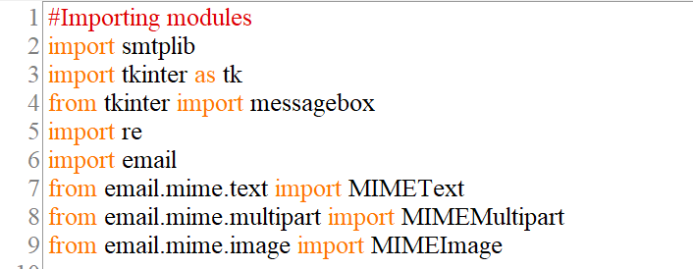


smtplib
tkinter
re
email
email.mime.text
MODULES USED

Slide 4


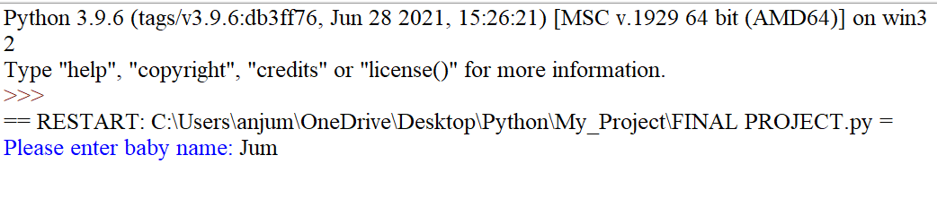
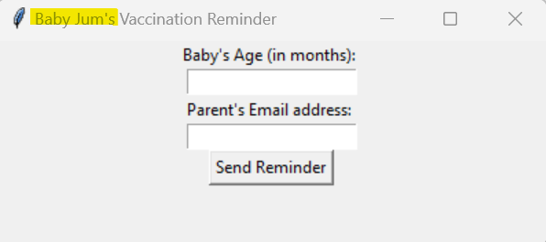
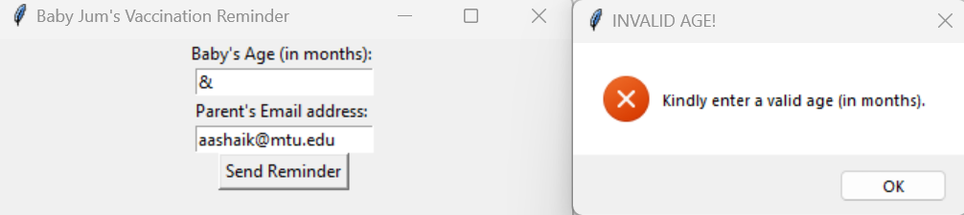
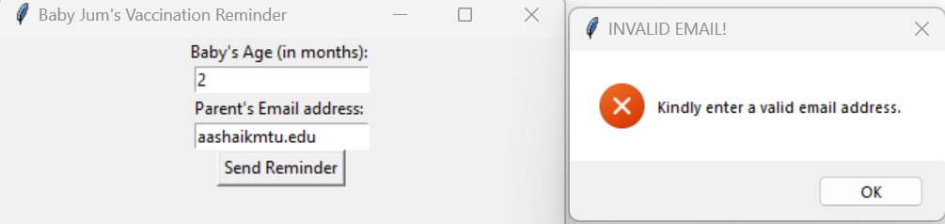
#Collecting the Baby info - name
Baby_name = input(str("Please enter baby name: "))
#Function for sending e-mail reminders
def send_an_email():
#Collecting the Baby info - age
Baby_age = Baby_age_entry.get()
print(f"{Baby_name}'s age: ", Baby_age)
#Figuring if given age is valid or not
try:
Baby_age = float(Baby_age)
except ValueError:
messagebox.showerror("INVALID AGE!", "Kindly enter a valid age (in months).")
return
#Collecting the Baby info - Parent email address
Parent_email = Parent_email_entry.get()
print("Sent email to: ", Parent_email)
#Figuring if given email address is valid or not
if not re.match(r"[^@]+@[^@]+\.[^@]+", Parent_email):
messagebox.showerror("INVALID EMAIL!", "Kindly enter a valid email address.")
return

Slide 5
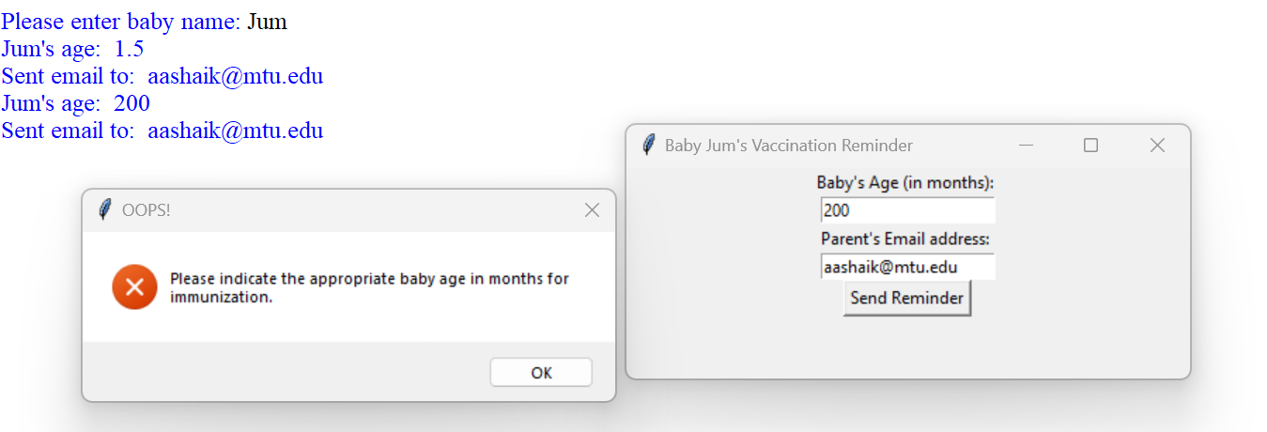
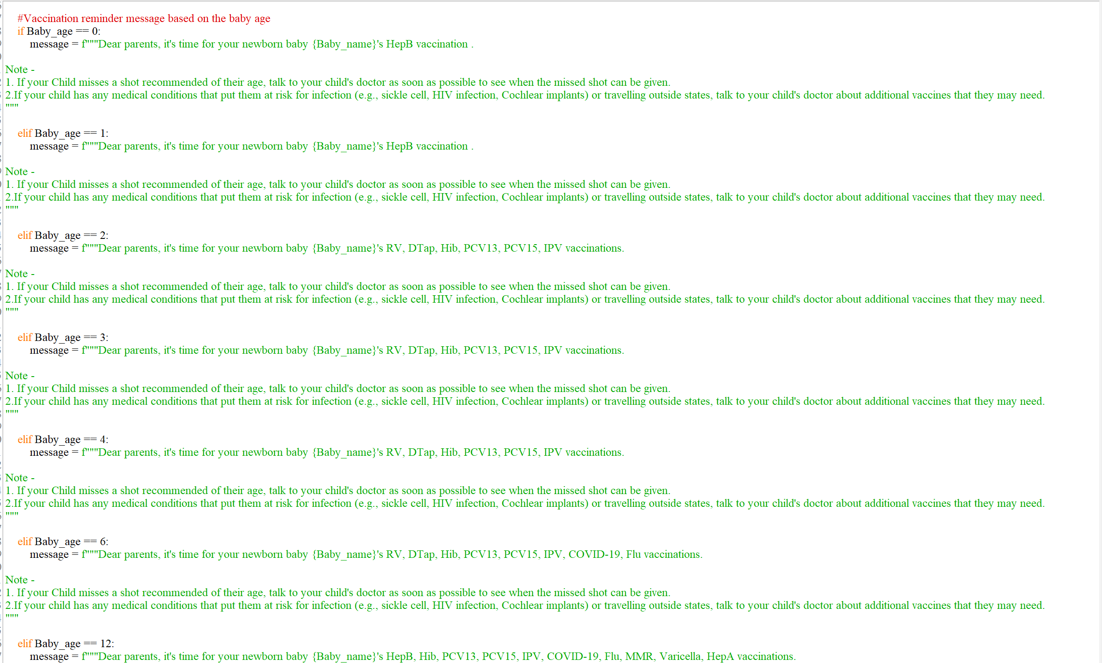
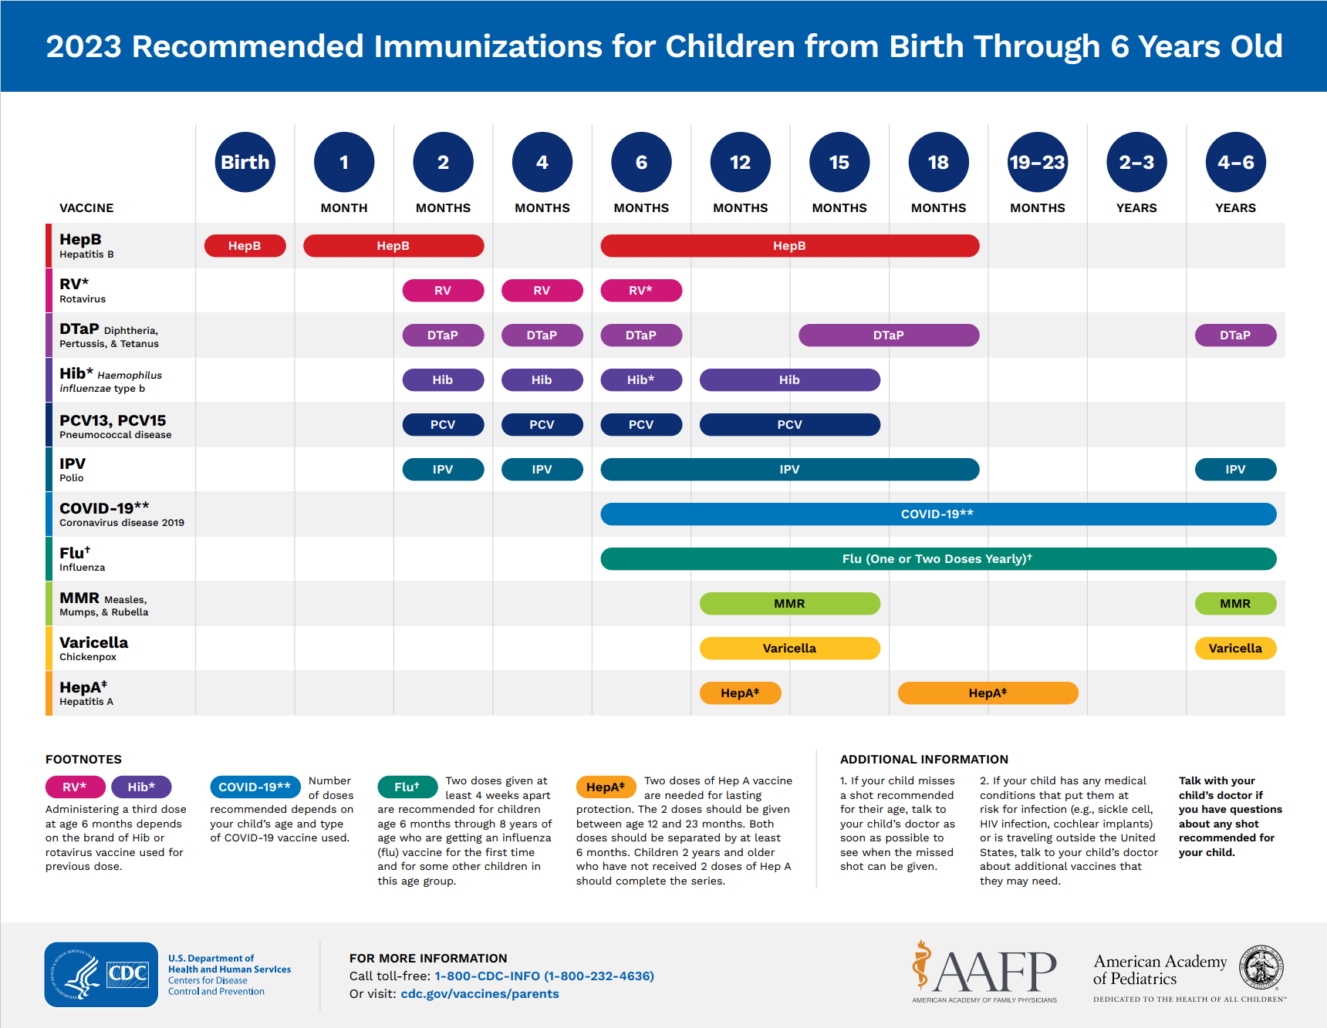
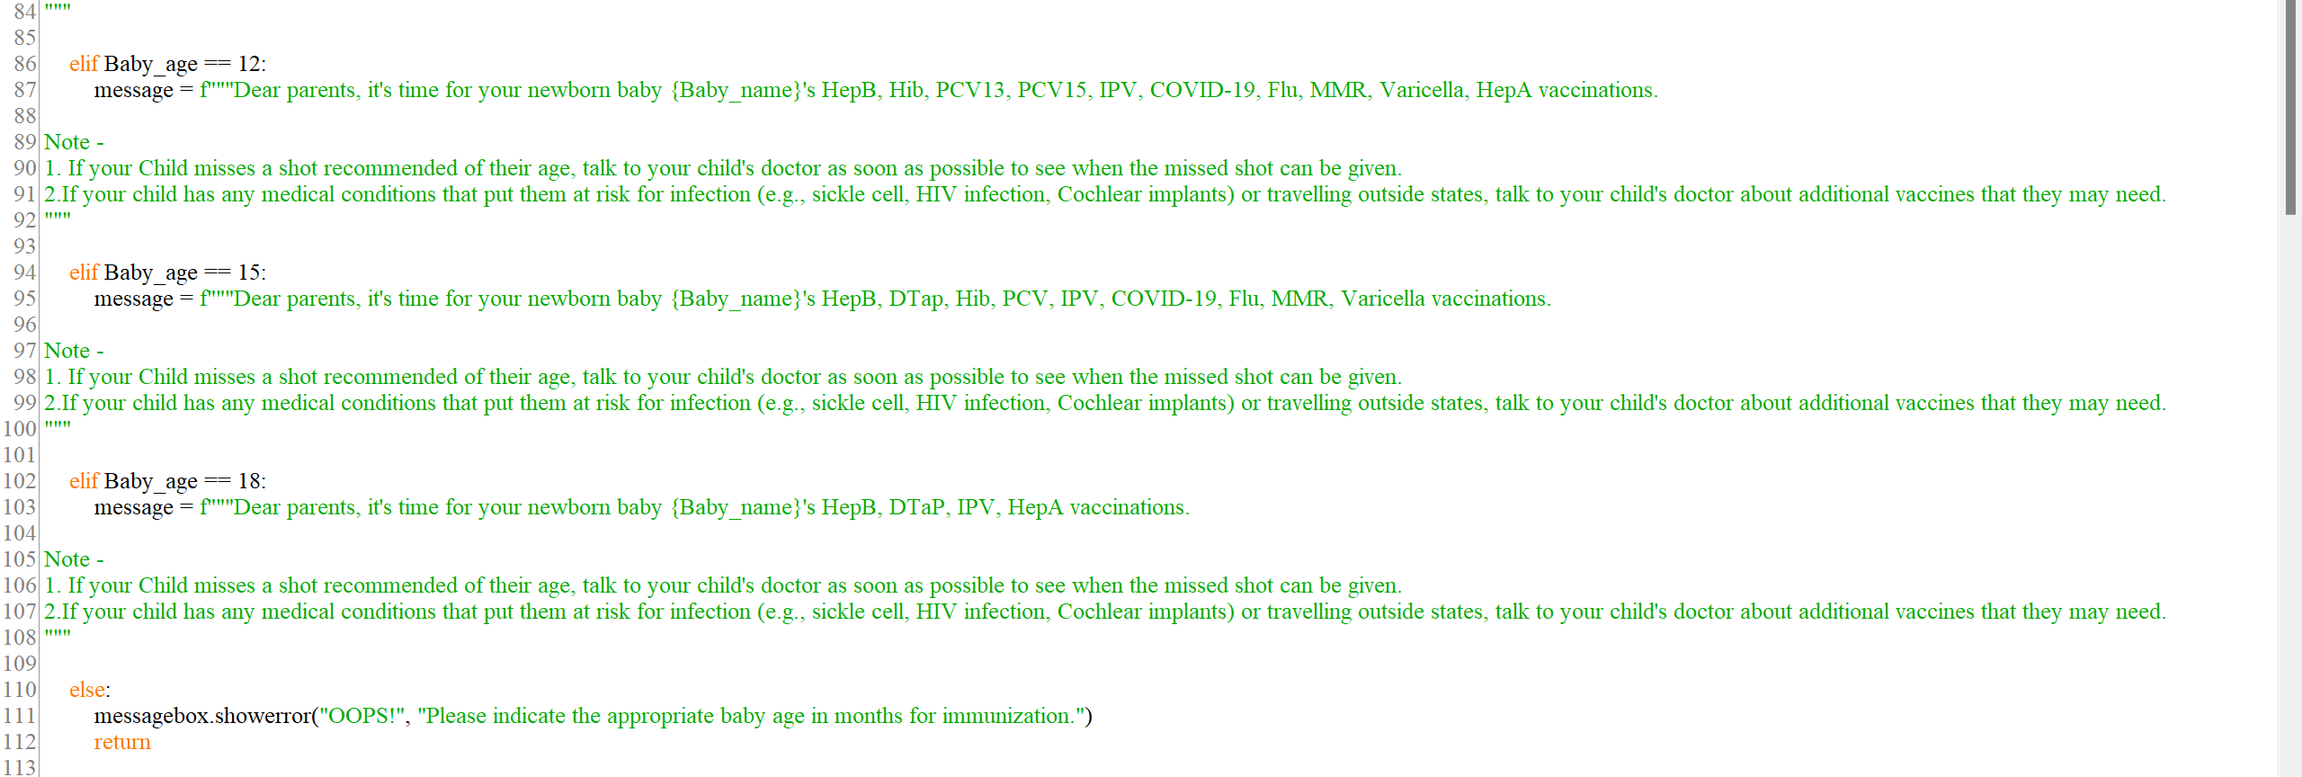

Slide 6


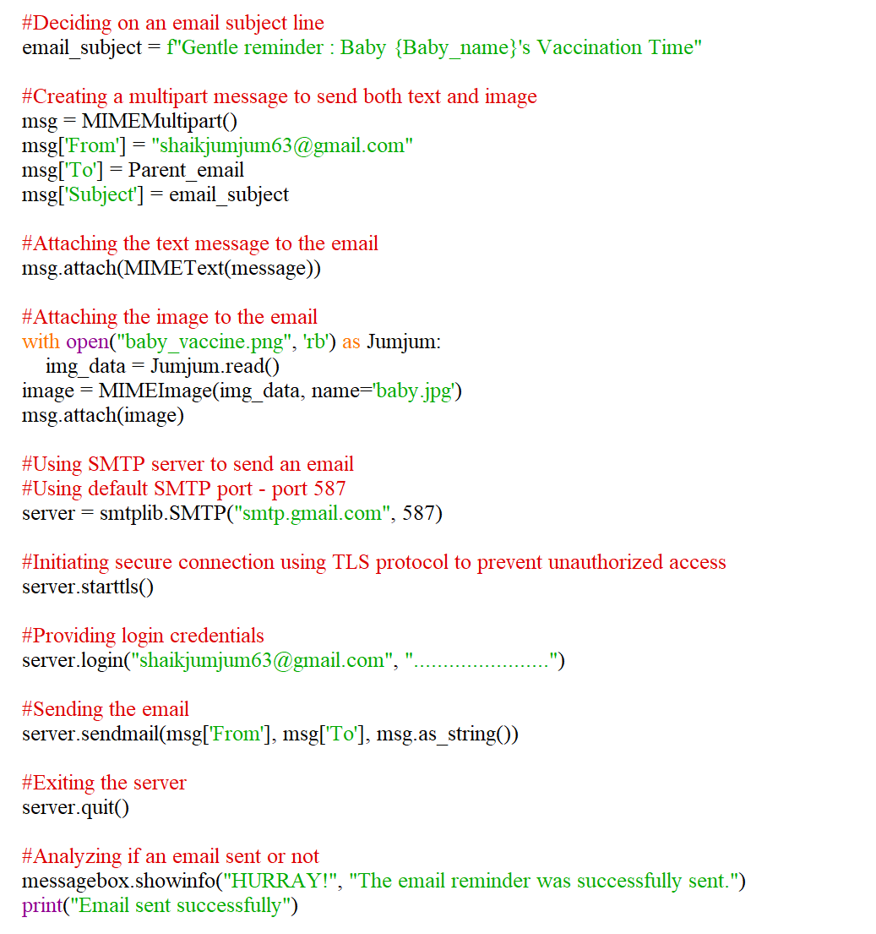
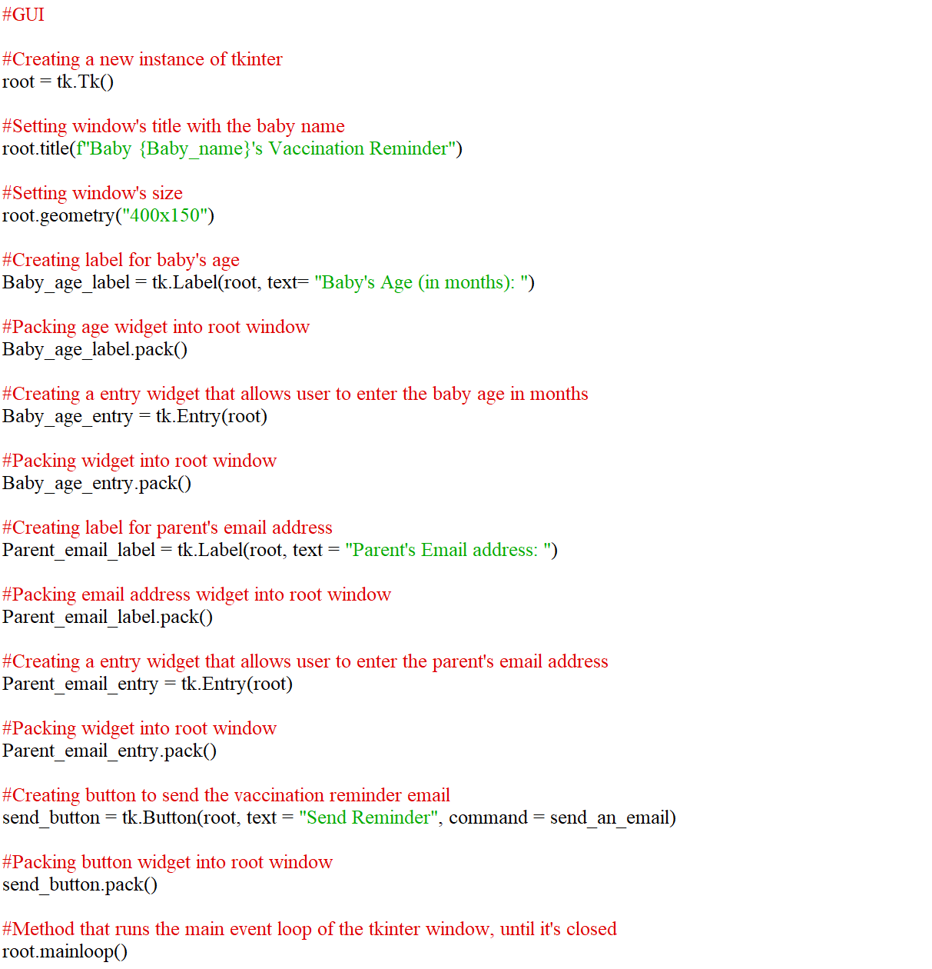



Slide 7


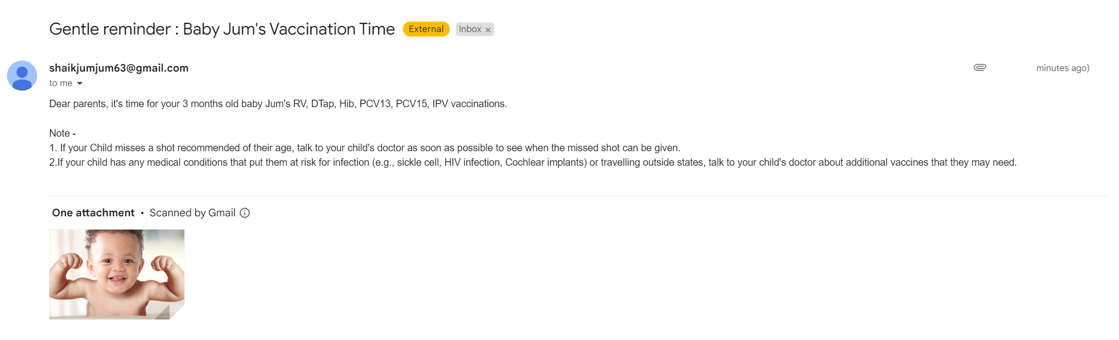
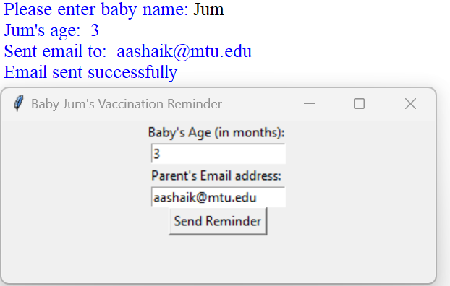
A NEW BABY IS LIKE THE BEGINNING OF ALL THINGS - WONDER, HOPE, A DREAM OF POSSIBILITIES.
OUTPUT
REFERERNCES
Canvas Modules
CDC - https://www.cdc.gov/vaccines/schedules/easy-to-read/child-easyread.html
Tkinter - https://www.python-course.eu/python_tkinter.php
Email.mime - https://docs.python.org/3/library/email.mime.html
CHALLENGES
The SMTP server settings should be correctly configured for the email to be sent.
If- else statements : content should be accurate and informative

